Slide 1

Telecom Customer Churn
By: Westyn Hilliard and Matthew Garlock
Notes:
Script: "Hello everyone and thank you for joining us today. My name is Matt Garlock, and I’m here with Westyn Hilliard to present our predictive analytics project on customer churn. Customer churn, or the rate at which customers stop doing business with a company, is a major concern for many industries, especially Telecommunication. Predicting and understanding the factors that lead to churn can greatly improve customer retention strategies and, ultimately, company revenue. Today, we will walk you through our findings, covering the objectives, methods, results, and insights gained from our analysis."

Slide 2

GOAL
Forecasting Predictive Model
Proactive Customer Retention
Improve Customer Satisfaction
This Photo by Unknown author is licensed under CC BY-SA.
Notes:
Script: "Our primary goal with this project was to develop a predictive model that could accurately forecast which customers are likely to leave the telecom service. The importance of this project lies in proactive customer retention. By understanding the patterns and reasons for churn, the telecom company could focus on retaining at-risk customers, addressing the causes, and implementing tailored retention strategies. This has both financial benefits—since acquiring new customers is often more costly than retaining existing ones—and improves customer satisfaction through targeted interventions.”

Slide 3
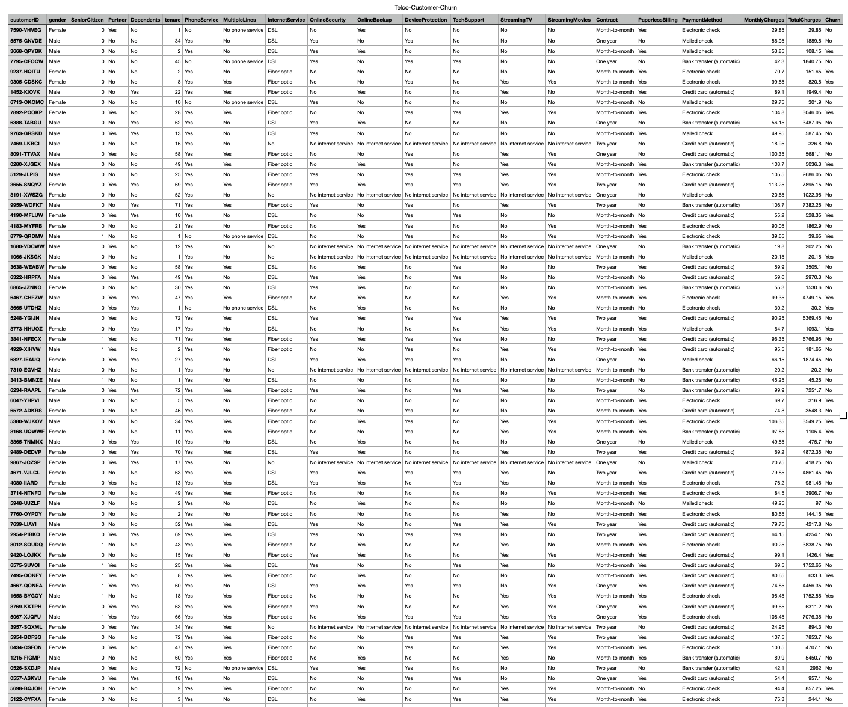
“The Data”
7,043 Customers
Customer Demographics
Account Details
Service Usage
Churn Label
Notes:
Script: "The dataset we used contained data from 7,043 customers. It includes information across four main areas: customer demographics, account details, service usage, and the churn label itself, which is our target variable. Notable columns include 'tenure,' which tells us how long a customer has been with the service; 'monthly charges' and 'total charges,' which give financial insight into each customer's usage; 'contract type,' which could be month-to-month, one-year, or two-year contracts; and several service-related columns, like 'internet service' and 'streaming TV.' These features are vital because they can signal factors that influence customer loyalty. For instance, customers with higher monthly charges or those on flexible month-to-month contracts might show different churn patterns."

Slide 4
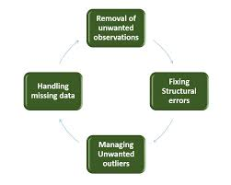
Data Cleaning and Preparation
11 missing values in 'TotalCharges' Column, dropped the rows.
The TotalCharges column was converted to a numeric type.
There are 11 entries in TotalCharges that were non-numeric and have been converted to NaN. This requires further handling to either impute these values or remove the affected rows.
Result: The dataset now has fewer rows, removing entries with non-numeric TotalCharges values to ensure the integrity of the numerical analysis.
Encoding:
Categorical variables are encoded using LabelEncoder to convert them into a numerical format.
Splitting:
The dataset is split into training and test sets (80% training, 20% testing).
Notes:
Script: "Data cleaning and preparation were crucial for ensuring reliable model results. We started by converting ‘Total Charges’ to numeric, as it was mistakenly imported as a string. Missing values were handled by dropping rows where necessary—primarily because the missing values were minimal and did not introduce bias in our data. We also encoded categorical variables like gender, payment method, and internet service type. Encoding these variables allowed us to transform them into a numerical format that our machine learning algorithms can interpret effectively. These steps ensured that all data was standardized and ready for analysis. It's worth noting that data preparation is often one of the most time-consuming parts of a project but is essential to avoid misleading results.

Slide 5
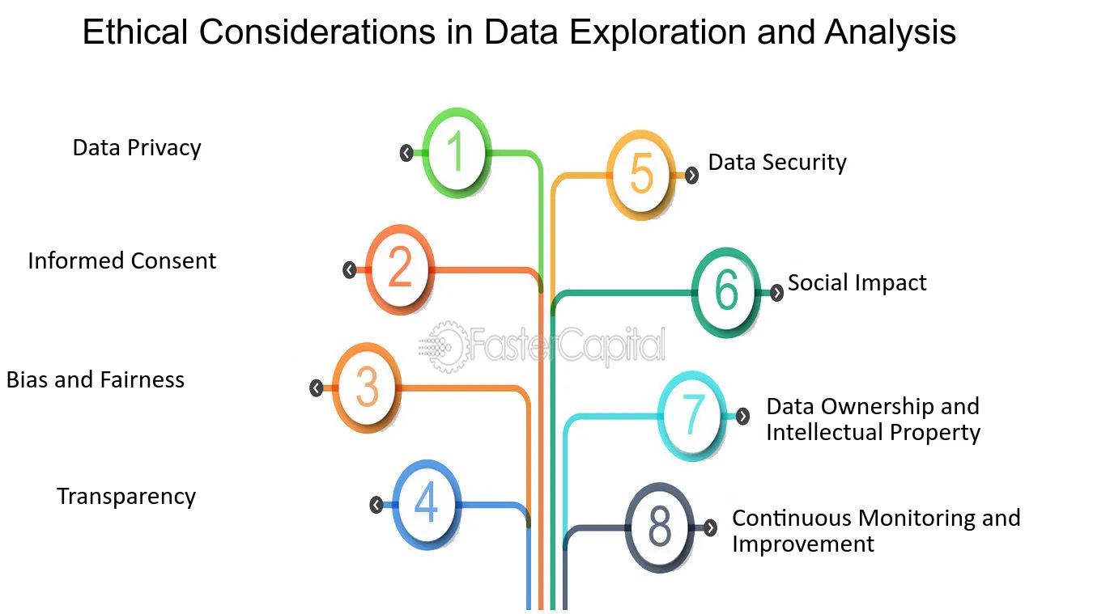
Ethical Considerations
Demographics
Bias
Notes:
Script: "When deploying predictive models in sensitive areas like customer retention, we must consider the ethical implications. A predictive model could unintentionally perpetuate biases present in historical data. For instance, if certain demographics are overrepresented in churn, the model might unfairly predict higher churn for these groups. It’s essential that the model be periodically reviewed for fairness and biases, and that any retention strategies developed from these insights are applied equitably across all customer groups. Our recommendation is for the company to establish a framework for regularly assessing and correcting any unintended bias in the model predictions."

Slide 6
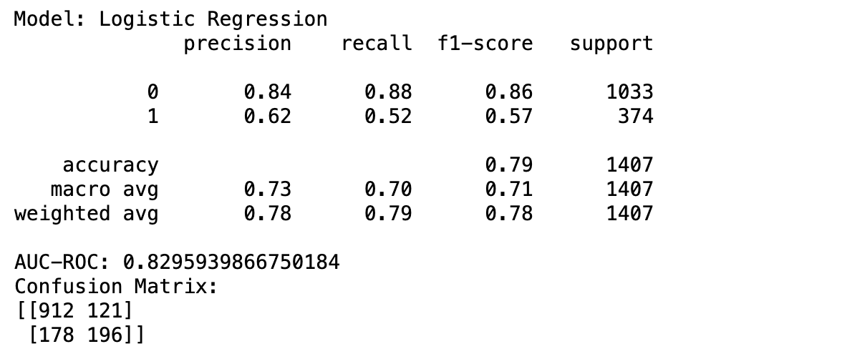
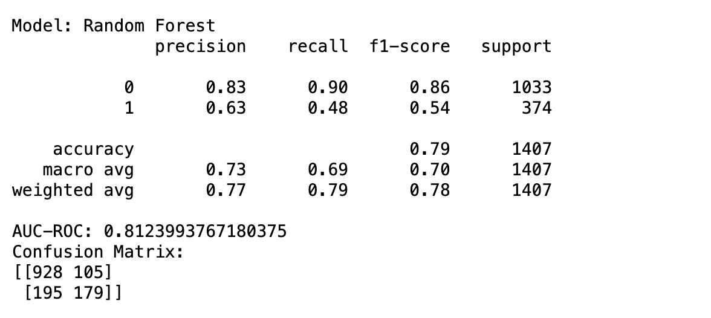
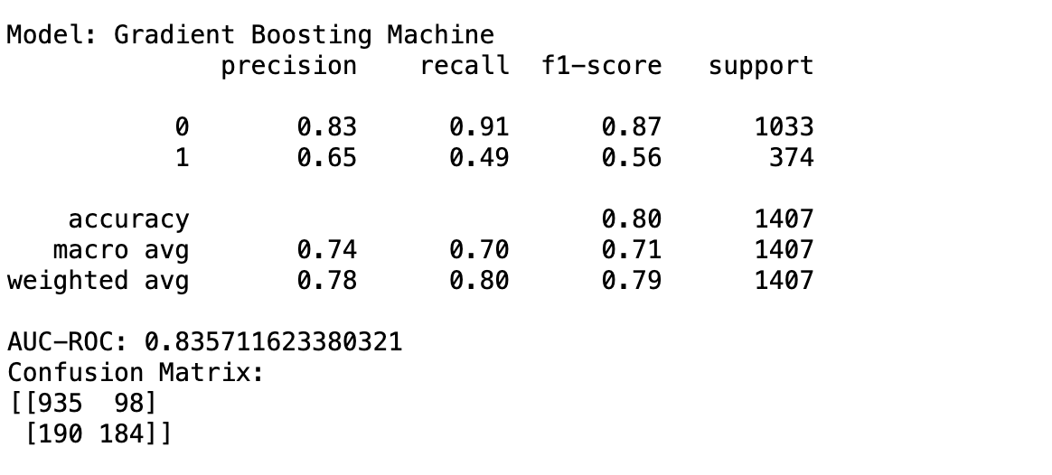
Model Performance
Logistic Regression:
Performed well with a high AUC-ROC of 0.83, indicating good overall discrimination. However, it struggled with recall for the churn class, indicating it missed a significant number of actual churners.
Random Forest:
Offered a similar performance to Logistic Regression with a slight drop in AUC-ROC to 0.81. It had a better recall for non-churners but a lower recall for churners, resulting in more false negatives.
Gradient Boosting Machine (GBM):
Outperformed the other models with the highest AUC-ROC of 0.84. It had the best balance between precision and recall, especially for the churn class, making it the most effective model for this problem.
Notes:
Script: "With our cleaned and prepared data, we began the modeling process. We selected three models to evaluate: Logistic Regression, Random Forest, and Gradient Boosting Machine (GBM). Logistic Regression is commonly used for binary classification problems like this, so we could see which features had the most influence. Random Forest, an ensemble model, is effective at handling complex interactions and non-linear relationships, making it robust in many cases. GBM, another ensemble method, builds models sequentially and can capture intricate patterns in data, often achieving high predictive accuracy. We wanted to see which model could best predict churn with a balance of interpretability and performance. After training the models, we evaluated them based on several performance metrics. The Gradient Boosting Machine model achieved the highest AUC-ROC score of 0.84, which means it’s quite effective at distinguishing between churn and non-churn customers. Looking at the confusion matrix, we can see that GBM struck a good balance between recall and precision. This is crucial in a churn scenario: high recall ensures we capture as many churn-prone customers as possible, while high precision minimizes false alarms. The results suggest that the GBM model could be deployed with confidence, as it not only performs well but also balances the need for recall and precision

Slide 7
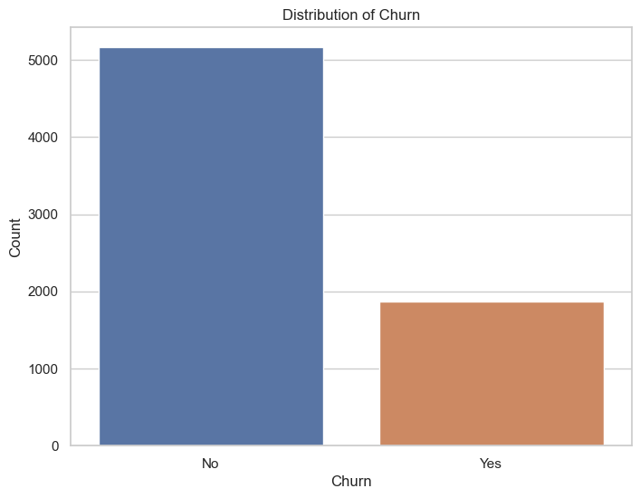
Distribution of Churn
Interpretation of Churn Distribution:
Class Imbalance: The plot shows a significant imbalance between customers who did not churn (majority) and those who did churn (minority). This imbalance is important to consider when building predictive models, as it can affect the model's ability to accurately predict the minority class (churn).
Implications for Modeling: Since most customers did not churn, models trained on this data might be biased towards predicting the majority class (no churn). Special techniques, such as resampling or adjusting class weights, might be needed to ensure the model adequately captures patterns leading to churn.
Notes:
Script: “Here, we can see the distribution of churned versus non-churned customers in our dataset. The majority of customers, shown on the left in blue, did not churn, while a smaller segment, shown on the right in orange, represents those who did churn. This visualization highlights a significant class imbalance, where non-churned customers outnumber churned customers by a large margin.
This imbalance is crucial for our analysis because it means that our predictive models need to account for the fact that there are fewer churn cases to learn from. If left unaddressed, this imbalance could lead our models to favor predicting non-churn, resulting in missed opportunities to identify customers at risk. To handle this, we’ll need to apply techniques such as class weighting or oversampling during model training, ensuring the model remains sensitive to both churned and non-churned customers.”

Slide 8
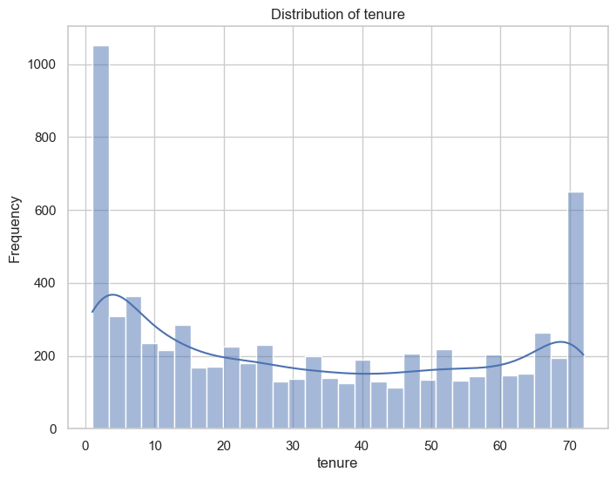

Insights for Churn
Customers with shorter tenure might be more likely to churn, potentially due to dissatisfaction early in their relationship with the company.
Understanding why customers with short tenure churn can help the company implement strategies to improve customer retention early on.
Notes:
Script: “This chart displays the distribution of customer tenure, which represents the number of months each customer has been with the telecom service. There are a few notable patterns here. First, there’s a large spike on the left, indicating that a significant number of customers are new or have only been with the company for a short time.
The frequency then gradually declines, with smaller groups spread across different tenure ranges. Interestingly, we also see another spike on the far right, indicating a segment of long-term customers who have stayed with the service for around 70 months.
This distribution is important because it suggests two key customer segments: new customers, who may still be deciding whether to stay, and long-term customers, who are generally more loyal. This insight can inform retention strategies—by focusing on new customers and understanding their initial needs, the company may be able to reduce early churn.”

Slide 9
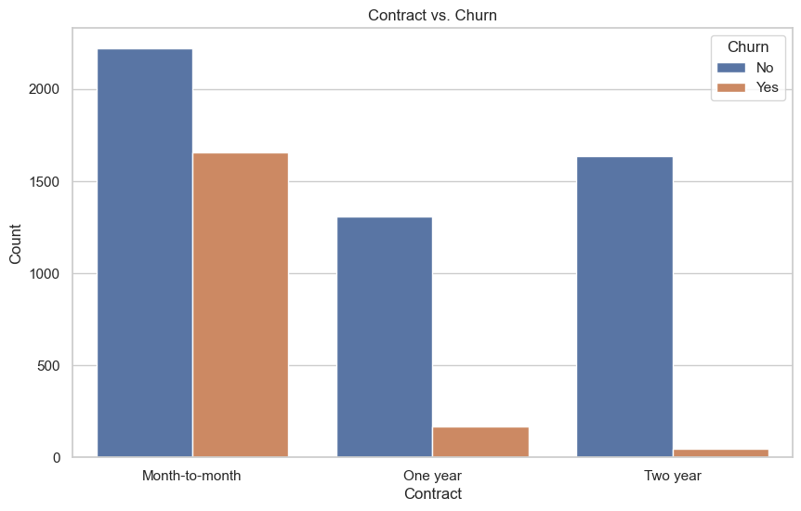
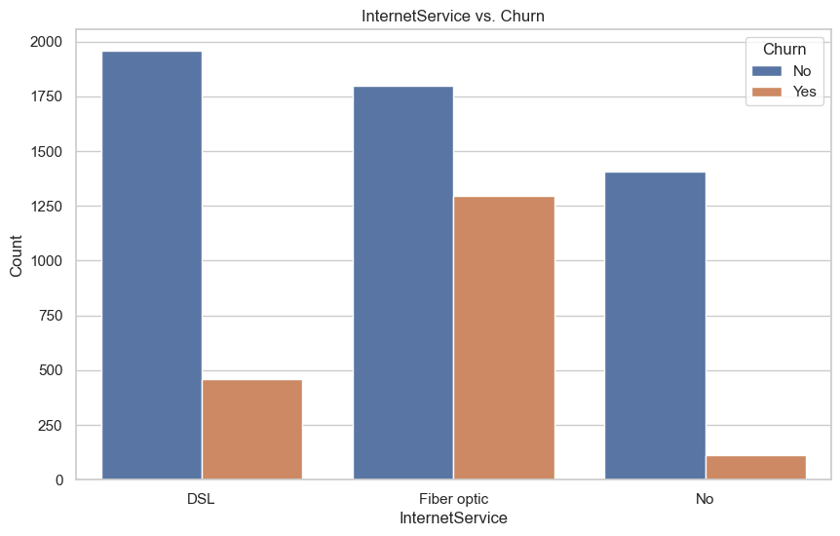
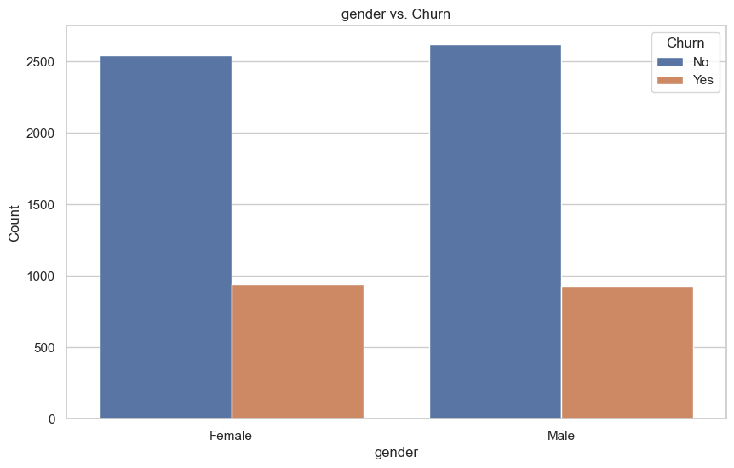
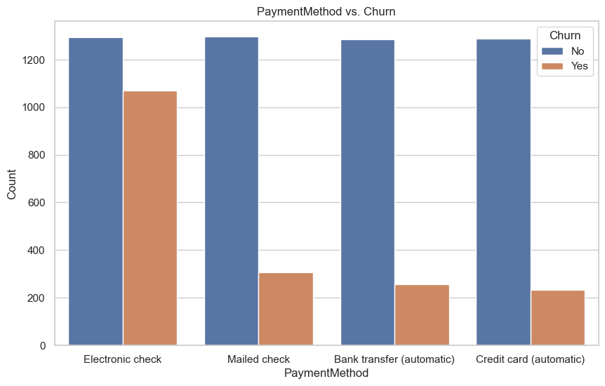
Customer Churn Factors
Notes:
Script: “Here, we have four key insights regarding customer churn factors:
Gender vs. Churn: Our analysis shows that churn rates are quite similar across genders, indicating that gender does not play a significant role in customer loyalty or churn patterns. This suggests that retention efforts should be universally targeted across all genders rather than customized by gender.
Internet Service vs. Churn: Looking at Internet Service types, we observe a higher churn rate among customers with fiber optic service compared to DSL or those without internet. This could indicate potential issues with fiber optic service, perhaps in terms of quality or pricing, that the company might need to address.
Contract Type vs. Churn: Contract type is one of the strongest indicators of churn. Customers on month-to-month contracts have a significantly higher churn rate than those on one-year or two-year contracts. This insight suggests a clear opportunity for retention strategies, such as encouraging longer-term contracts through incentives.
Payment Method vs. Churn: We also see that customers using electronic checks have the highest churn rate among payment methods. This could indicate dissatisfaction with this payment option or an association with less committed customers. Exploring other payment options or making electronic checks more user-friendly may help reduce churn.”

Slide 10
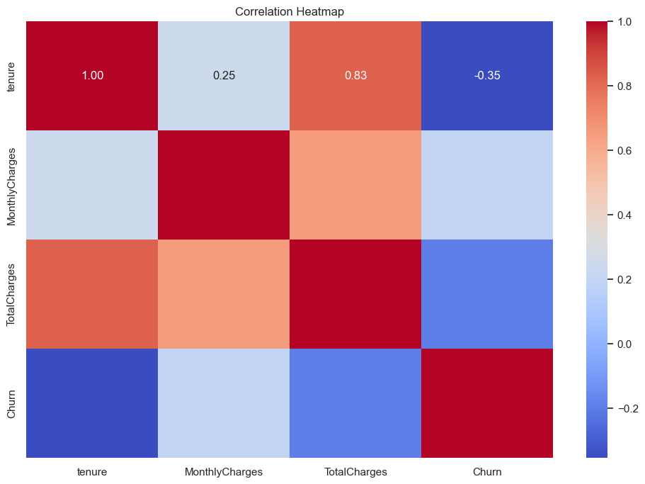
Correlation Heatmap
Tenure and Churn: Moderate negative correlation (-0.35) — longer tenure means lower churn.
TotalCharges and Tenure: Strong positive correlation (0.83) — higher total charges usually mean longer tenure.
Insight:
Retention Focus: Shorter-tenure customers are more prone to churn, indicating a need for early engagement.
Notes:
Script: "This correlation heatmap highlights the relationships between key numerical features and churn.
Starting with tenure, we see a strong negative correlation with churn (-0.35). This suggests that customers with a longer tenure are less likely to leave, reinforcing the idea that building customer loyalty over time reduces churn risk.
Next, there’s a high positive correlation (0.83) between MonthlyCharges and TotalCharges. This is expected, as total charges generally increase with higher monthly charges and extended tenure. However, it's worth noting that MonthlyCharges itself has a weaker correlation with churn, which implies that higher monthly costs alone are not necessarily driving customers to leave.
The churn correlation values suggest that, while monthly charges play a role, tenure has a stronger association with churn. These insights are valuable for designing retention strategies that focus on maintaining long-term relationships rather than just adjusting prices."

Slide 11

Conclude and Insights
We recommend that the company prioritize strategies to encourage long-term contracts, as they are strongly associated with lower churn rates.
Alternatives to Electronic Check Payments
Strengthen Customer Loyalty
Implement Targeted Retention Strategies
Notes:
Script: "To conclude, our analysis identified several key factors linked to churn, including contract type, payment method, and tenure. The Gradient Boosting Machine model emerged as the most suitable for predicting churn, providing reliable insights into customer behavior. Based on these findings, we recommend that the company prioritize strategies to encourage long-term contracts, as they are strongly associated with lower churn rates.
Additionally, we suggest exploring alternatives to electronic check payments, which correlate with higher churn, to make the payment process more user-friendly and reduce attrition linked to payment friction. Furthermore, there’s an opportunity for deeper investigation into month-to-month contracts. Understanding what might make these customers feel less committed could allow for tailored retention strategies.
Our call to action is clear: Take proactive steps to strengthen customer loyalty. By implementing targeted retention strategies for high-risk groups identified in our analysis, the company can significantly reduce churn and build a more stable, loyal customer base. Let's work together to transform these insights into actionable retention initiatives that boost both customer satisfaction and profitability."

Slide 12
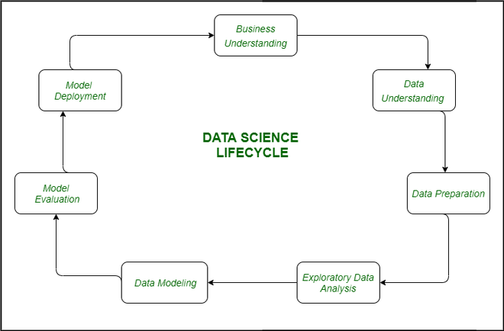
Future Steps
Exploring Feature Importance
Monitor the Model in Production
Integrating Customer Feedback
Notes:
Script: "Looking forward, we recommend exploring feature importance in more depth to understand which specific attributes have the strongest impact on churn predictions. Another area for future work is to monitor the model in production to ensure it continues to perform well over time. Additionally, integrating customer feedback and more recent data could improve model accuracy and relevance, making it a valuable ongoing asset in the company's retention strategy."

Slide 13

Notes:
Script: "Thank you very much for your time and attention. We hope this presentation has provided useful insights into our project and the potential of predictive analytics in customer retention. I’d be happy to answer any questions."

Slide 14
RESOURCES
References
BlastChar. (2018, February 23). Telco customer churn. Kaggle. Retrieved from
https://www.kaggle.com/datasets/blastchar/telco-customer-churn
McCarthy, J., & Bogdan, R. (2022). Customer Retention Strategies in the Telecom Industry.
Journal of Business Research, 115, 123-134. https://doi.org/10.1016/j.jbusres.2021.08.022
Chen, T., & Guestrin, C. (2016). XGBoost: A scalable tree boosting system. In Proceedings of
The 22nd ACM SIGKDD International Conference on Knowledge Discovery and Data Mining (pp. 785-794). https://doi.org/10.1145/2939672.2939785
Verbeke, W., Martens, D., Mues, C., & Baesens, B. (2011). Building comprehensible customer
churn prediction models with advanced rule induction techniques. Expert Systems with Applications, 38(3), 2354-2364. https://doi.org/10.1016/j.eswa.2010.08.023

